Slide 1


Publishing Your Resume with GitHub
A workshop created by Steven Gsell

Slide 2
What are we doing?
Taking advantage of GitHub pages to host a resume & portfolio website.
Creating a custom QR code linking to our website to add to our resume showcasing your higher education!
Exploring how GitHub can be used to organize your projects as they accumulate.
This workshop is for everyone regardless of GitHub / Coding familiarity!

Slide 3
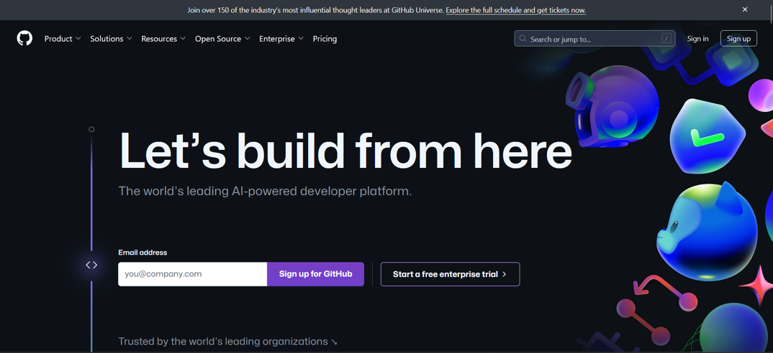
Create a GitHub account
Head on over to https://github.com and create an account.
A student email is preferable, but any will work.
a student email has benefits presented later in the presentation

Slide 4
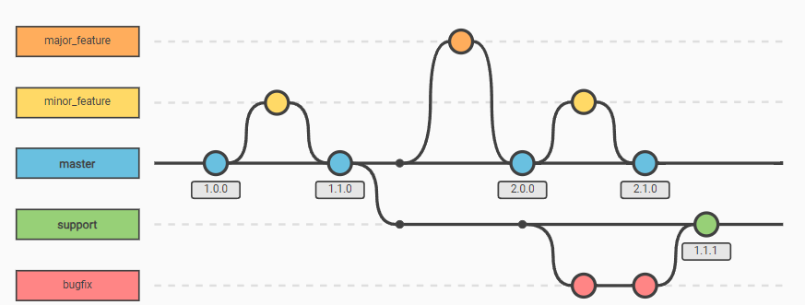
What is GitHub?
GitHub is an incredibly powerful and free platform to share code.
It allows easy collaboration and version control in group settings.

Slide 5
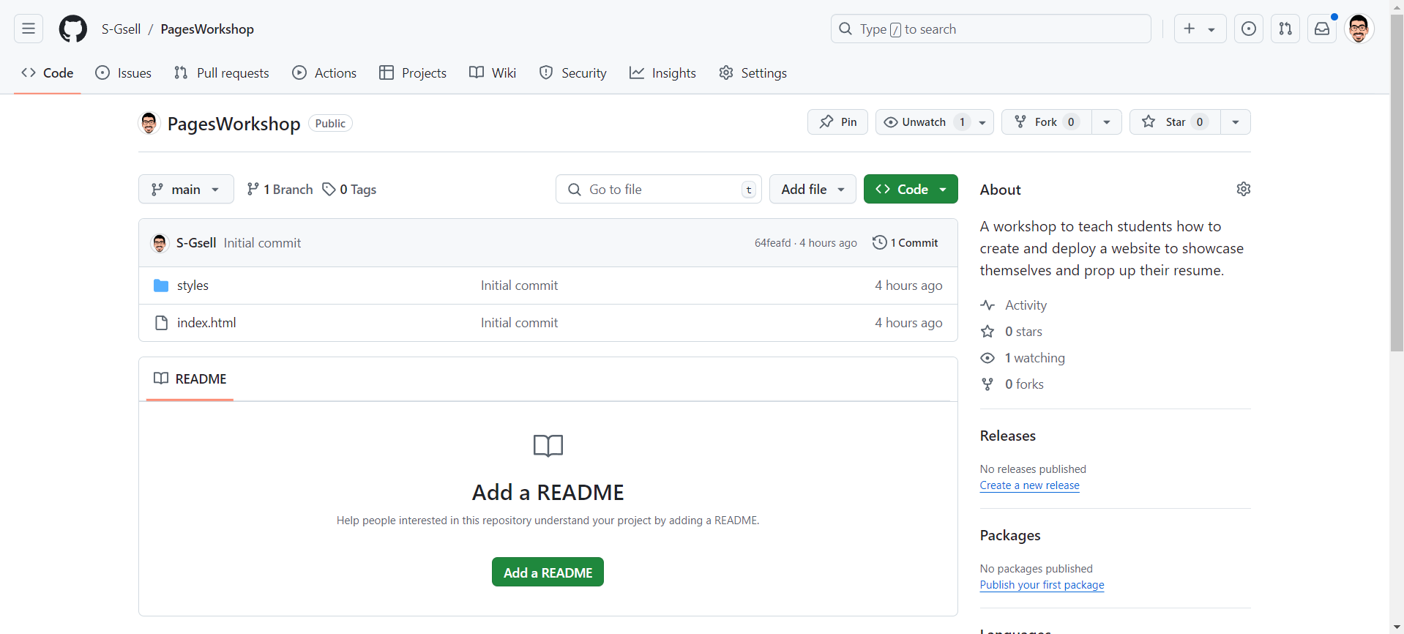
Fork (copy) my repository
Log in to your new github account
Head on over to https://github.com/S-Gsell/PagesWorkshop to fork (copy) my template.
Click Fork > Create a new fork
Rename your repository if you want. Click “Create fork”

Slide 6
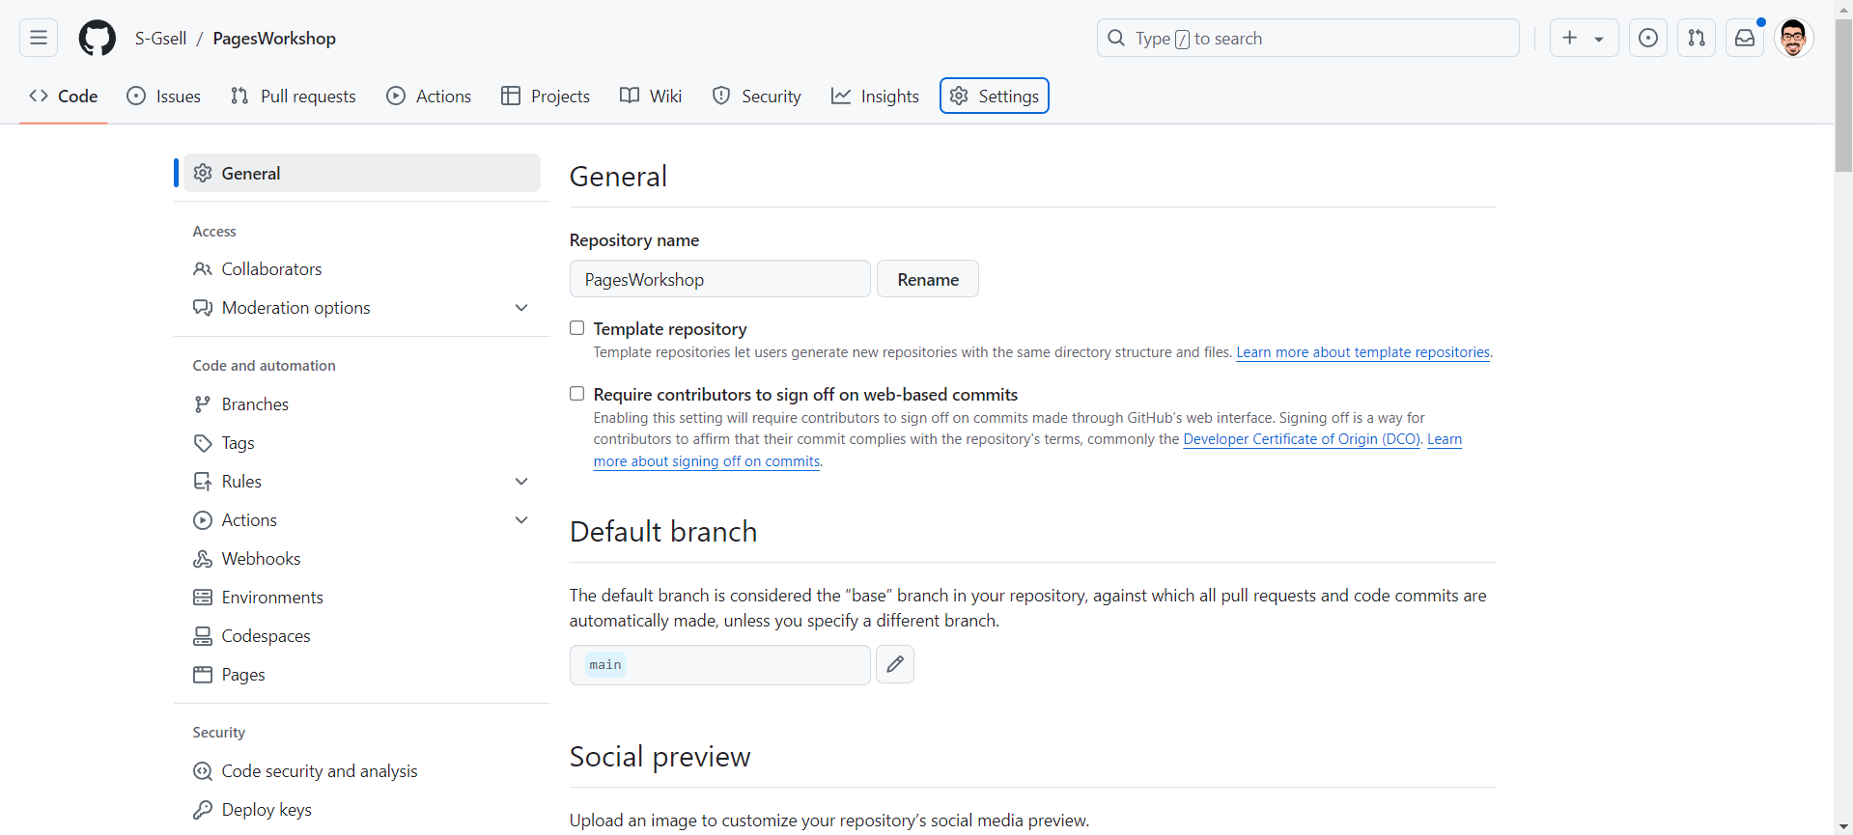
Navigate to Pages
In your repository go to the settings tab and click on the pages option
1
2

Slide 7
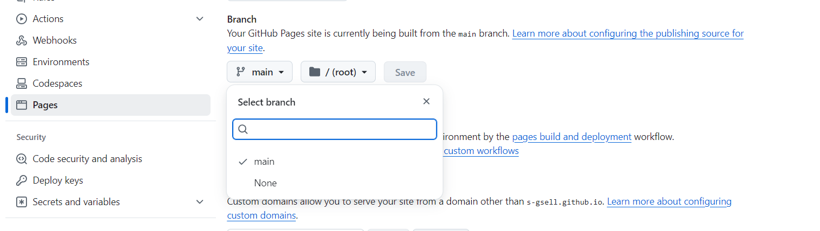
Deploy your website
Under the branch option, click the dropdown that says “None” and change it to “main” and click the save button.
1
3
2

Slide 8
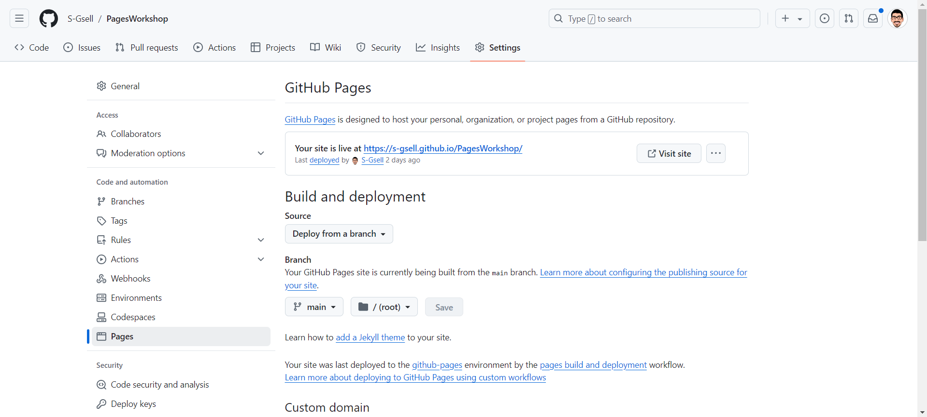
Visit your website
After a minute or so refresh your page. You should now see a new box at the top of the page with your website URL. Click on the “Visit site” button to see your website you are in control of!

Slide 9
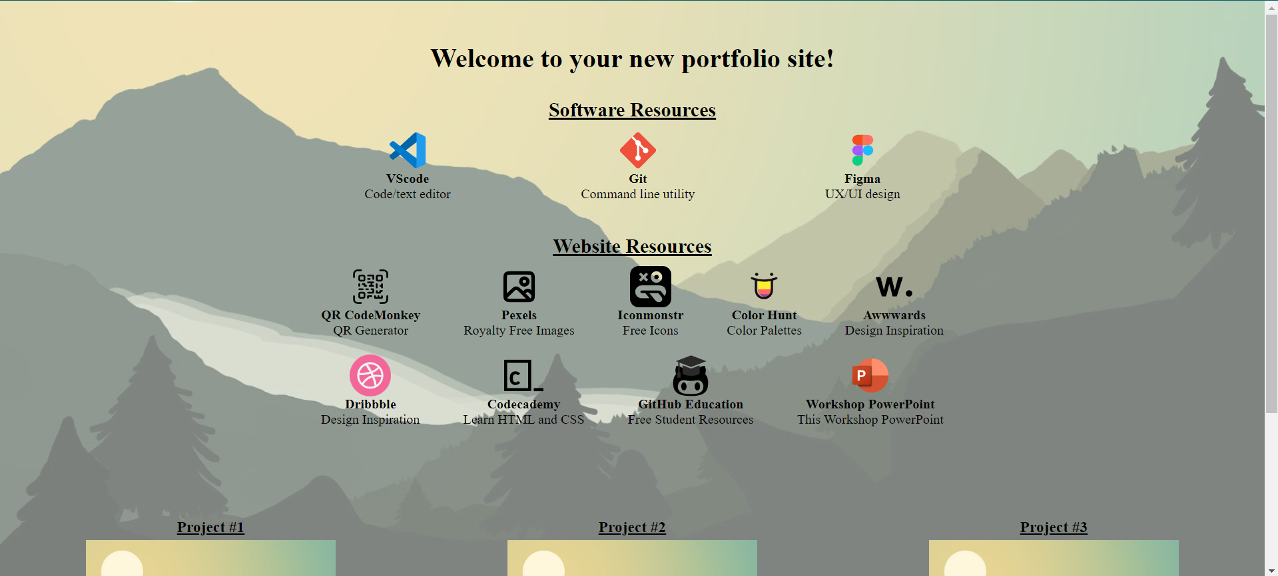
Admire your website

Slide 10

Install Git
Download Git
There is a download link on your new website!
You may need to restart your computer if you just installed Git for your computer to recognize the “git” command
Right click your desktop and open a command prompt.
Type git config --global user.name “Your Name”
Type git config --global user.email “Your Email”
Keep the command prompt window open.
Navigate back to your repository and get your repository git URL from the Code tab
This is NOT your website URL

Slide 11
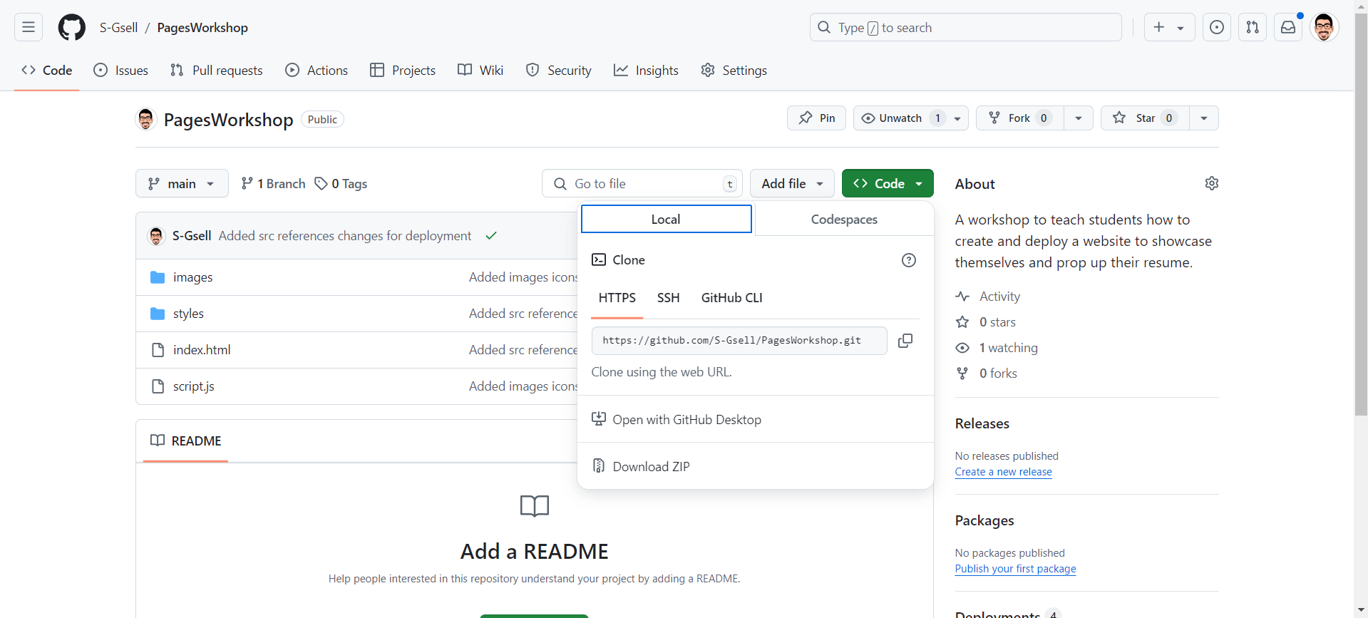
Clone your repository
Copy this link and navigate back to your command prompt
Type git clone YourLink
1
2
3

Slide 12

Install VSCode
You will now see your website files on your desktop!
Download VSCode
There is a download link on your website!
Open VSCode and Click Open Folder and navigate to your new folder
Open the index.html file in the navigator to the left
Where you see the “Welcome to your new portfolio site!” message simply change to text to your name or any message you would like.

Slide 13
Adding your Resume
Drag and drop your personal resume file into the “files” directory in your project
Feel free to delete the placeholder “resume.pdf” file
Scroll down the index.html file and under the <!--Projects Section --> comment find the <a> element with the id “resumeDownload” and change the href attribute to what your resume file name is
For example, if your resume file is named JohnSmithResume.pdf the path would be changed to ./files/JohnSmithResume.pdf
Save your changes (File > Save or Ctrl + S).
Congratulations! Now when anyone visiting your site clicks the “Download my Resume” button on your site it will be downloaded to their computer!

Slide 14
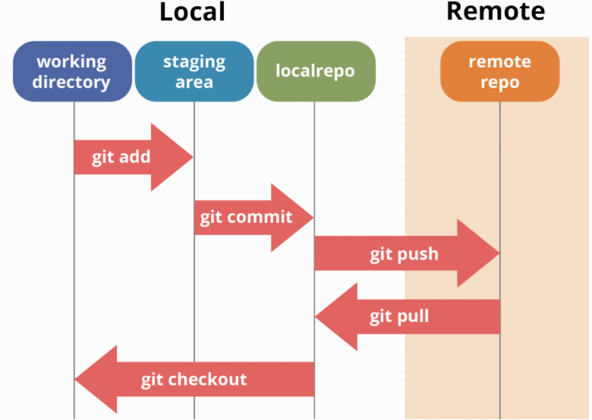
Push your changes
Open a new terminal in VSCode with Terminal > New Terminal
In the VSCode Terminal type
git add *
git commit –m “Updated my HTML”
git push origin main

Slide 15

Create a QR code
On your new website you will see some links to tools available. Click on the QR code generator icon and it will take you to QR-CodeMonkey.
Copy your URL from your new site and paste it into the “Your URL” section on QR-CodeMonkey.
Click the Green “Create QR Code” button
You can edit the colors and shapes within the QR code in the settings below if you like.
Once you are done you can click download PNG or .SVG below depending on your desired format.

Slide 16
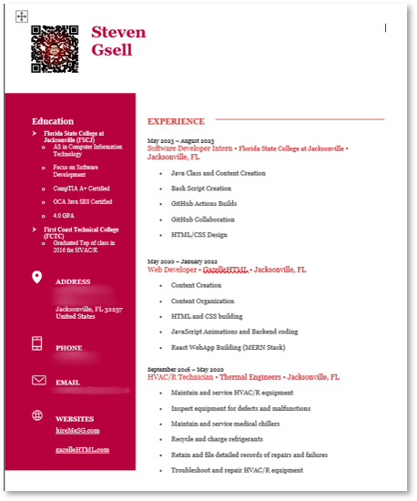
What to do with your QR code
This is a powerful tool to add because it gives quick access to your online oasis that can let your personality shine.
Add it to the corner of your resume.
Put it on some business cards.
Add it to any physical or digital item that you want to represent yourself.

Slide 17
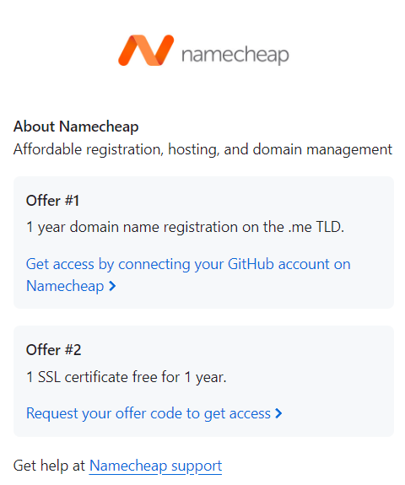
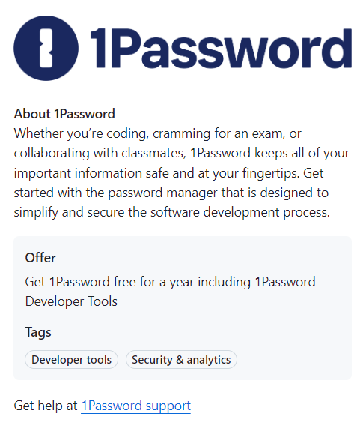
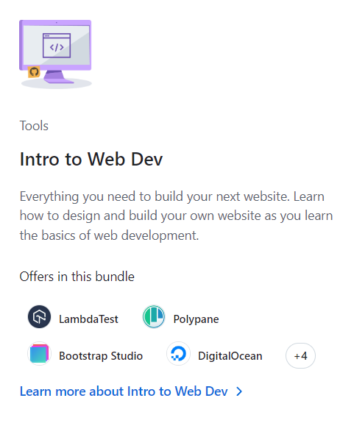
GitHub Education
Students have access to GitHub Education packs that contain amazing deals
Domain .me name for a year
GitHub Pro (allows you to host a private repository on pages)
So many other things!

Slide 18
Resources
VSCode – Text editor
Git – Command Line tool
Figma – UX/UI design tool
QRCode Monkey – QR Code generator
Pexels – Royalty Free Images
IconMonstr – Free icons
ColorHunt - Cohesive color palettes
Codecademy – Learn HTML/CSS for web page design
GitHub Education – Free Student resources (TAKE ADVANTAGE OF THIS!!!)

Slide 19

Extra customization
Follow the Pexels link on your website
Download an image that represents you well
Rename the file to “background.jpg”
Place it into the images folder in your website files
Select to replace the existing file
In the VSCode Terminal
git add images
git commit –m “Updated my background image”
git push origin main

